Slide 1



Major Project Report
Industrial Training Project Reporterggeegwer
On
Technology Training in AWS, Spark and Data Engineering
Submitted By:
Nirbhay Kumar (219302192)
Under the Guidance of
Dr. Lokesh Sharma
Department of Information Technology School of Information Technology Manipal University Jaipur 2024-2025

Slide 2

Internship Overview
Company Name: Cognizant Location: Coimbatore , Tamil Nadu Duration: 3 Months
Role: Programmer Analyst Trainee
Project: Technology Training in AWS, Spark and Data Engineering
Internship Overview:
During my internship at Cognizant, I focused on Big Data, Spark, Databricks, and AWS Data Engineering as part of the structured learning curriculum. The program included self-paced learning, conceptual facilitation, and doubt clarification sessions. Key areas covered were data processing, cloud computing, and ETL workflows. This training provided a strong foundation for working with large-scale data pipelines and cloud- based solutions.

Slide 3

PROBLEM STATEMENT
With the growing reliance on Big Data and Cloud Technologies, organizations face challenges in efficiently processing, analyzing, and managing large datasets. Traditional data processing methods often struggle with scalability, real-time processing, and integration with cloud platforms.
This project aims to address these challenges by leveraging Big Data frameworks (Spark, Databricks) and AWS Data Engineering services to develop scalable, high-performance data pipelines. The goal is to enable efficient data ingestion, transformation, and visualization, ensuring real-time insights and optimized data workflows.

Slide 4
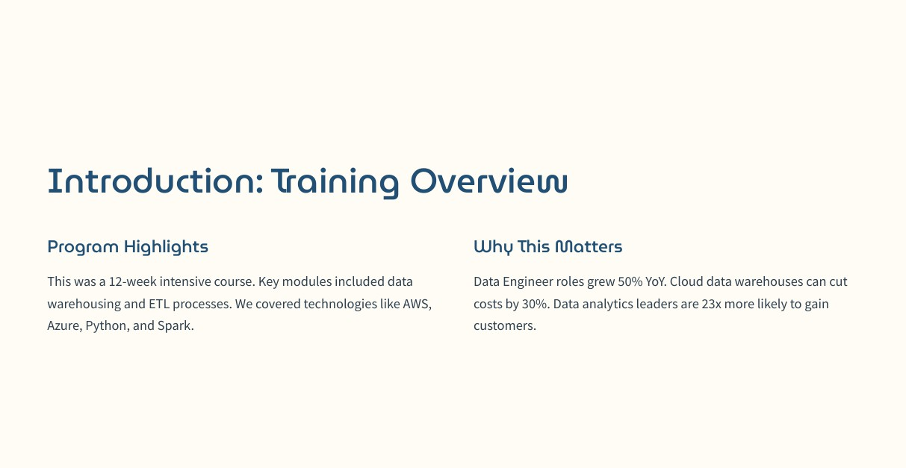

Slide 5
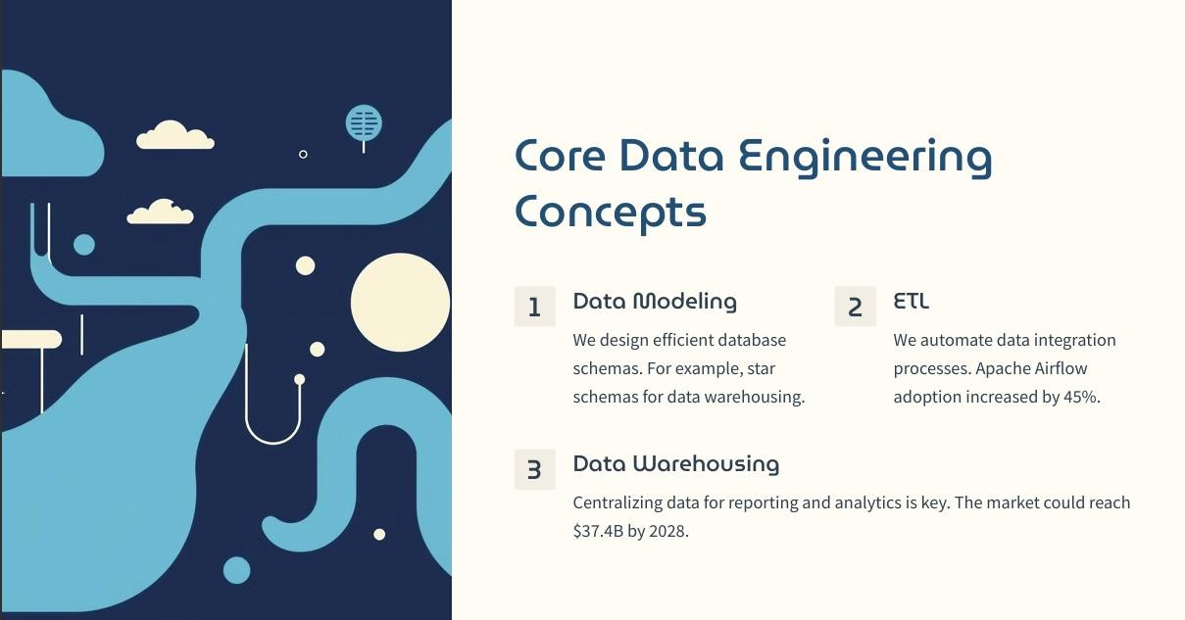

Slide 6
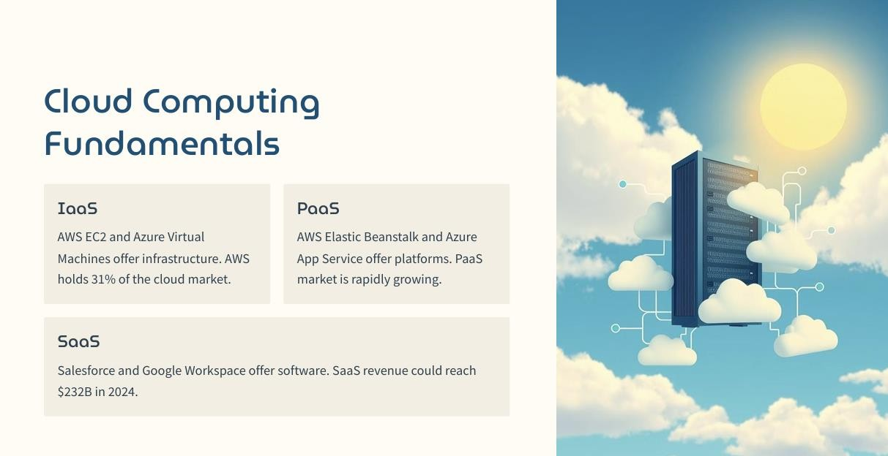

Slide 7
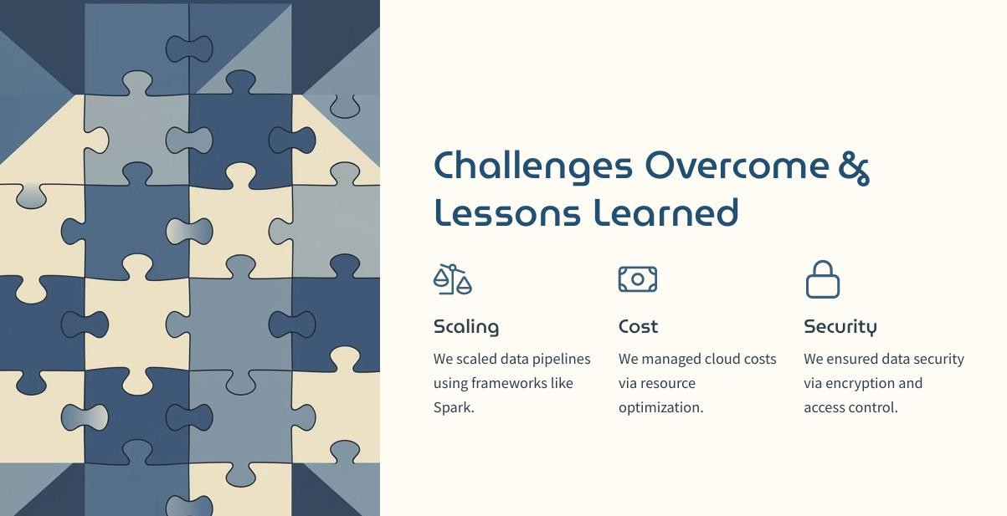

Slide 8
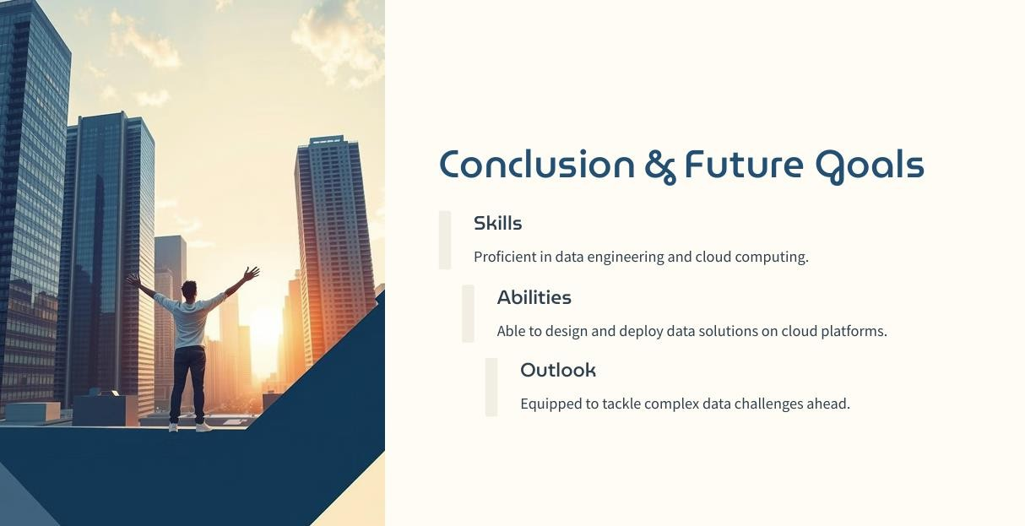

Slide 9
THANK YOU!
We appreciate your time and attention.
Let's revolutionize collaborative coding together!

